Slide 1
Analysis of Use Cases: Asynchronous vs Parallel Programming
Shreyash Bhardwaj (MSRCASC)
Shilpa Nayak (MSRCASC)

Slide 2
INDEX
Abstract
Introduction
Key Differences
Methodology
Results & Analysis
Conclusion

Slide 3
ABSTRACT
Software systems evolution poses the challenge of balancing performance optimization with responsiveness and scalability, prompting the exploration of asynchronous and parallel programming paradigms.
The paper conducts a thorough analysis of these paradigms across various use cases, assessing their effectiveness in meeting performance objectives and navigating the complexities of modern software systems.
It begins by defining asynchronous and parallel programming paradigms, highlighting their key differences and typical application scenarios.
The analysis delves into specific use cases where each paradigm demonstrates proficiency, including web server applications, real-time systems, and data processing pipelines.
Through a comparative study, the paper elucidates the tradeoffs associated with each approach, focusing on factors like concurrency control, resource utilization, and code maintainability, aiming to offer practical guidance for programmers in selecting the most suitable paradigm for their scenarios.

Slide 4
INTRODUCTION
Optimization of performance, responsiveness, and scalability is crucial in software development.
Asynchronous and parallel programming paradigms offer effective strategies to address this challenge.
The paper titled "Analysis of Use Cases: Asynchronous vs Parallel Programming" comprehensively analyzesa these paradigms.
It explores their fundamental principles, application scenarios, and comparative advantages across various use cases.
By highlighting tradeoffs in concurrency control, resource utilization, and code maintainability, the research aims to guide developers in selecting the appropriate programming paradigm for their projects.
Real-world scenarios, including web server applications, real-time systems, and data processing pipelines, are systematically examined to provide practical guidance for optimizing performance in modern software systems.

Slide 5
METHODOLOGY
Methodology Overview for Evaluating Asynchronous and Parallel Programming Paradigms:
Literature Review: Comprehensive review of academic papers, books, and technical documentation to understand foundational concepts and best practices.
Use Case Selection: Identify diverse use cases representing different domains and scenarios where these paradigms are commonly used, considering system requirements and performance goals.
Data Collection: Gather relevant data for selected use cases, including system specifications and performance metrics, through studying existing systems or conducting experiments.
Implementation and Experimentation : Implement asynchronous and parallel versions of selected use cases, design experiments to evaluate performance under various conditions, and measure key metrics such as execution time and resource utilization.
Analysis and Comparison: Analyze experimental results to identify trends and tradeoffs, compare performance across different use cases, and draw conclusions on the suitability of each paradigm for specific scenarios.

Slide 6
RESULTS AND ANALYSIS
Key Findings:
Each paradigm (Parallel or Asynchronous) excels in distinct scenarios.
For CPU-bound operations, Parallel Programming consistently demonstrates minimal execution times compared to Asynchronous Programming.
The efficiency of parallel processing in tasks with high CPU utilization is highlighted.
Programs were meticulously crafted to assess the utility of each paradigm across various scenarios.
Through systematic experimentation and analysis, the optimal choice of paradigm based on specific scenario characteristics and requirements was elucidated.

Slide 7
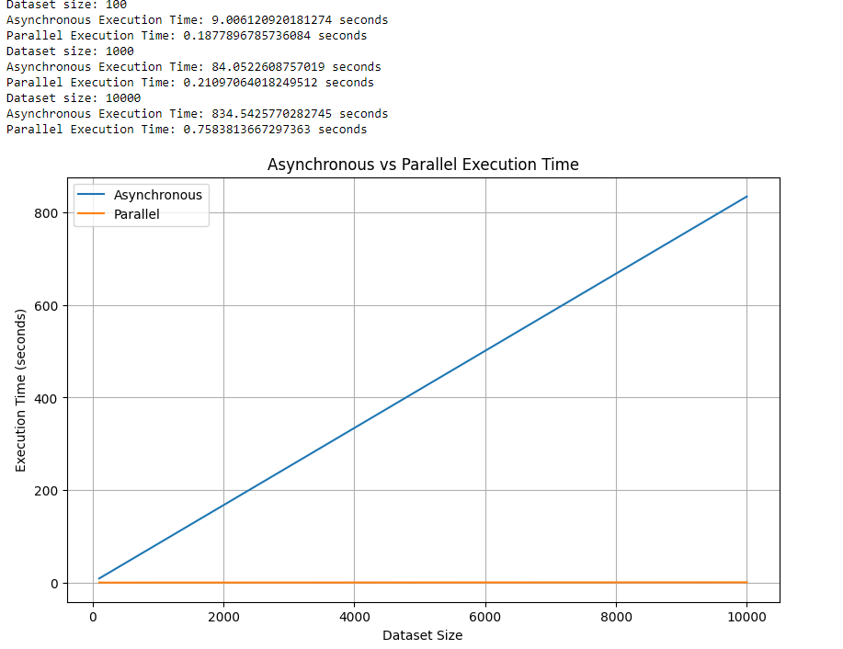
CPU Bound Operation
A CPU-bound operation relies heavily on the processing power of the CPU for execution. Its performance is primarily limited by the speed and capabilities of the CPU, rather than other system resources like memory, disk I/O, or network bandwidth. Examples : Mathematical Calculation, Image and Video Processing, Compilation etc.
In the first program, two functions representing asynchronous and parallel paradigms were created, each tasked with a simple operation of inducing a one-second delay, simulating CPU-bound tasks of varying durations. The output demonstrated that in both scenarios, parallel programming outperformed asynchronous programming, indicating its superior suitability for CPU-bound tasks.

Slide 8
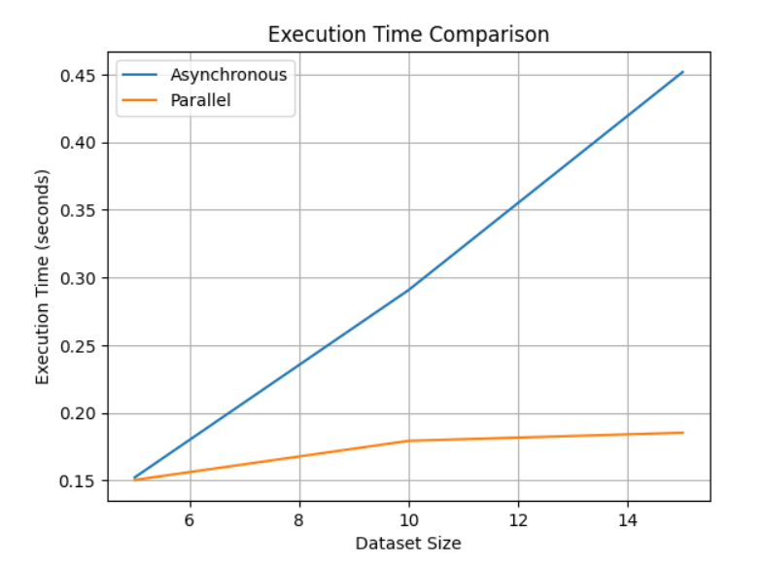
Similarly, in the second program, CPU-bound operations were simulated through the calculation of Fibonacci sequences. Again, functions representing asynchronous and parallel paradigms were devised to calculate Fibonacci sequences for varying datasets. The output revealed that parallel programming consistently exhibited faster execution times compared to its asynchronous counterpart

Slide 9
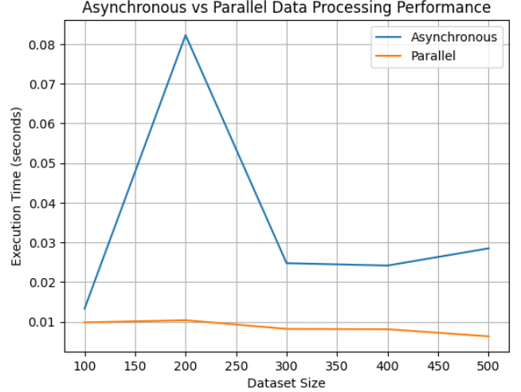
Data Processing
Data processing involves transforming raw data into actionable insights through operations such as organization, sorting, filtering, aggregation, analysis, and summarization. To determine the most appropriate paradigm for these tasks, two separate code implementations were developed for comparison.
In the initial program, the performance of asynchronous and parallel processing for a rudimentary data processing task was evaluated. A function was defined to execute the data processing task, which involved a simple multiplication operation. The program systematically measured the execution times for both asynchronous and parallel processing across various dataset sizes and presented the results graphically to illustrate the impact of dataset size on execution time for each processing paradigm.

Slide 10
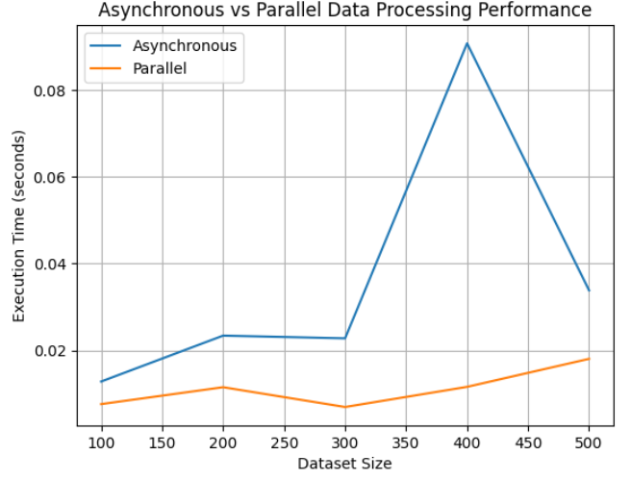
The second program scrutinized the performance of asynchronous and parallel processing for a more complex data processing task. Functions were formulated for asynchronous and parallel processing, each tasked with calculating the square root of numbers in a dataset. The primary function iterated over diverse dataset sizes, gauged the execution times for both paradigms, and tabulated the outcomes. Subsequently, the program visualized the execution times on a graph to elucidate the performance disparity between asynchronous and parallel processing approaches.

Slide 11
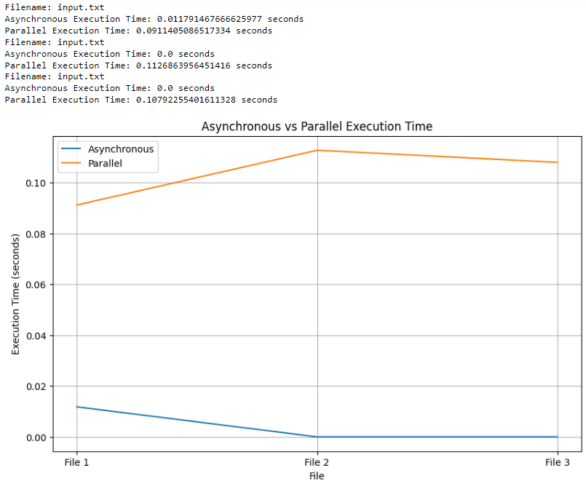
IO-Bound Operation
An I/O-bound operation primarily waits for input/output operations to complete, rather than actively using the CPU for computation. This limitation is determined by the speed of input/output devices like disk drives, network connections, or user input/output interfaces. To identify the most suitable paradigm for handling such operations, two separate code implementations were created for comparison.
In the first program, the execution times of processing files asynchronously and in parallel were compared. This entailed reading the contents of a file, transforming them to uppercase, and subsequently writing the processed content to a new file. Leveraging 'concurrent.futures', the script gauged the execution duration for each approach and rendered a graphical comparison for visual interpretation.

Slide 12
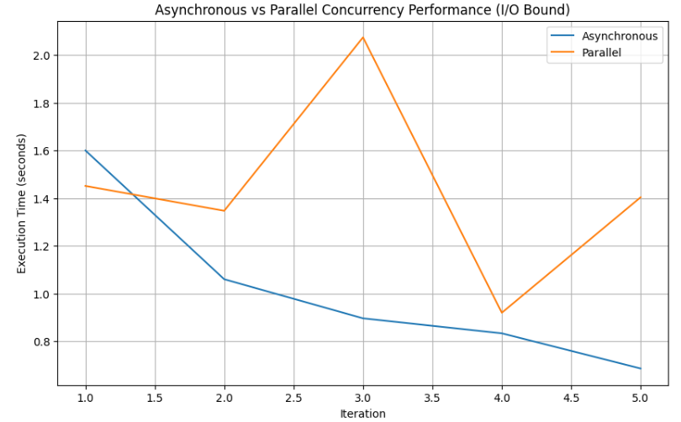
In the second program, the performance of asynchronous and parallel concurrency in retrieving images from URLs was juxtaposed. Employing `aiohttp`, images were asynchronously fetched, while `requests` and `concurrent.futures` were enlisted for parallel retrieval. Execution times for both methodologies were meticulously measured across multiple iterations, and the ensuing results were charted using `matplotlib` for comprehensive analysis

Slide 13
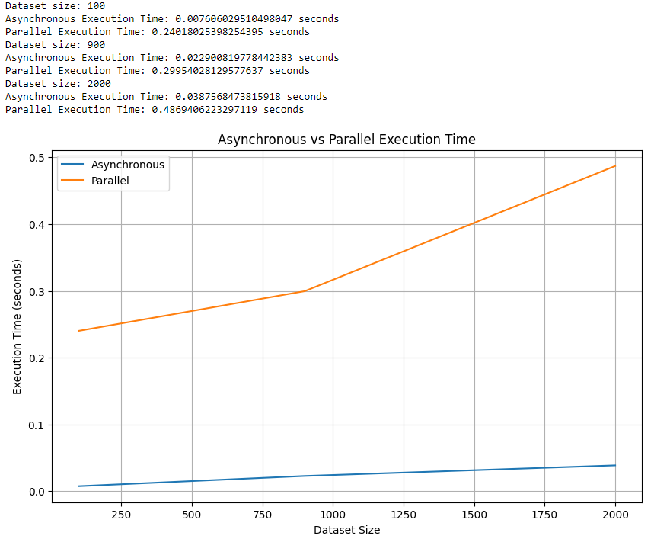
Concurrency
Concurrency involves a system's ability to handle multiple tasks or processes simultaneously, optimizing resource utilization and improving performance. While both asynchronous and parallel programming paradigms support concurrency, the aim was to assess their suitability. Two programs were created to compare their effectiveness in managing concurrency.
In the first program, both paradigms were tasked with executing the code "(i + 1) ** 2," simulating processing tasks on large datasets. The output demonstrated the efficiency of asynchronous programming in handling concurrency.

Slide 14
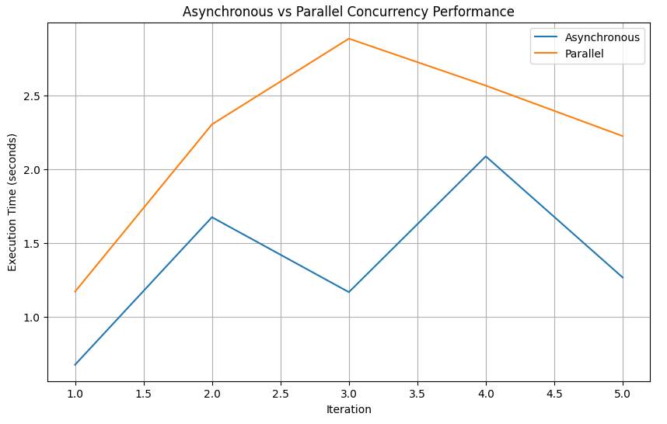
In the second program, the performance of asynchronous and parallel concurrency was compared in fetching data from URLs, visually represented through a graph. Utilizing the 'aiohttp' library for asynchronous requests and 'requests' for parallel execution, the output conclusively favored asynchronous programming for concurrency tasks.

Slide 15
CONCLUSION
The research conducted a thorough analysis of asynchronous and parallel programming paradigms in diverse use cases, highlighting their strengths and tradeoffs in optimizing performance and managing complexities in modern software systems.
Insights from real-world scenarios and empirical experimentation were synthesized to provide practical guidance for developers in selecting the appropriate programming paradigm.
Factors such as concurrency control, resource utilization, and code maintainability were considered when determining the suitability of each paradigm.
The research emphasizes the importance of continued exploration of emerging technologies and methodologies to refine performance optimization strategies.
Ultimately, the goal is to empower developers to design more efficient and scalable software systems, thereby driving innovation and progress in the field of software engineering.

Slide 16
THANK YOU

